Slide 1
Problem solving with linear equations
Solving linear equations

Slide 2
how to use Oak lessons

Slide 3
I can use my knowledge of solving linear equations to solve problems.

Slide 4
An equation is used to show two expressions that are equal to each other.
The solution to an equality is the value which, when substituted, maintains the equality between the expressions.

Slide 5

Problem solving with linear equations
Solving geometric problems
Forming and solving equations from worded problems

Slide 6
Solving geometric problems
We will encounter many examples where we use our knowledge of algebra to solve geometric problems.
For example, x = 3, find the perimeter of this rectangle.
(4x − 1) + (x + 2) + (4x − 1) + (x + 2)
x + 2
≡ 10x + 2
10(3) + 2 = 32
4x − 1
The perimeter is 32
But what if we had to work backwards in such a problem?

Slide 7
Solving geometric problems
The perimeter of this rectangle is 100. Find the value of x
2(4x − 7) + 2(5x + 3) | = | 100
8x − 14 + 10x + 6 | = | 100
18x − 8 | = | 100
18x | = | 108
x | = | 6
2(4x − 7) + 2(5x + 3) | = | 100
2(4x − 7) + 2(5x + 3) | = | 100
8x − 14 + 10x + 6 | = | 100
2(4x − 7) + 2(5x + 3) | = | 100
8x − 14 + 10x + 6 | = | 100
18x − 8 | = | 100
4x − 7
5x + 3
First, we need to form an equation that represents the situation.

Slide 8


Solving geometric problems
Which equation will help us to find the value of x if we know that the perimeter of this rectangle is 80?
x − 7
(x − 7) + (4x + 1) = 80
4x + 1
(x − 7) + (4x + 1) + (x − 7) + (4x + 1)
Whilst b) is an expression for the perimeter, it is not an equation.
2(x − 7) + 2(4x + 1) = 80
Two lots of each length being equal to the perimeter.

Slide 9
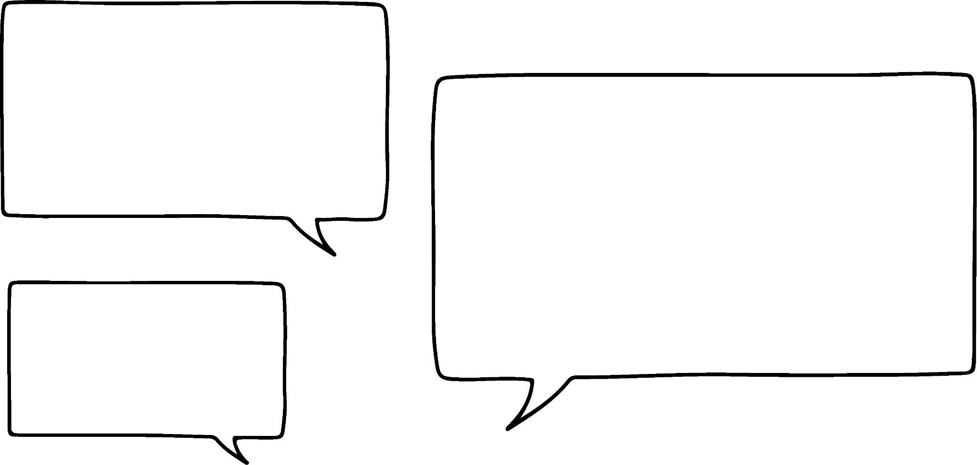


Solving geometric problems
Lucas is helping Sam solve this problem.
Find the perimeter of this square.
4x + 7
I know that an expression for the perimeter is 2(4x + 7) + 2(5x − 3) but I don’t know where to go from there?
5x − 3
What else do you know about the properties of a square?
What do you think Lucas is hinting at?

Slide 10
Solving geometric problems
Lucas is helping Sam solve this problem.
Find the perimeter of this square.
4x + 7
Equal lengths! That means 4x + 7 = 5x − 3
5x − 3
4x + 7 | = | 5x − 3
7 | = | x − 3
x | = | 10
4(10) + 7 = 47
4 × 47 = 188
Perimeter = 188

Slide 11
Solving geometric problems
To find the perimeter of this square which is a useful starting point?
2x + 1
8x − 46 + 4x + 2
4x − 23
2x + 1 = 4x − 23
An equation based on the property of ‘equal lengths’.
(4x − 23) + (2x + 1) + (4x − 23) + (2x + 1)
a) and c) are expressions for the perimeter but we can’t move forward without an equation to solve.

Slide 12
Solving geometric problems
1) The perimeter of this rectangle is 7. Work out the value of x
6x − 1
8x + 1
2) Find the perimeter of this equilateral triangle.
5x + 20
8x − 7

Slide 13
Solving geometric problems
3) Two identical rectangles make this compound shape with perimeter 48. Work out the value of x
x + 4
6x − 2

Slide 14
Solving geometric problems
4) The rectangle and the square have equal perimeters. Work out this perimeter.
8 − x
6x − 5
5x + 2

Slide 15
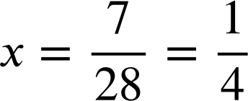
Solving geometric problems
1) The perimeter of this rectangle is 7. Work out the value of x
2(6x − 1) + 2(8x + 1) | = | 7
12x − 2 + 16x + 2 | = | 7
2(6x − 1) + 2(8x + 1) | = | 7
12x − 2 + 16x + 2 | = | 7
28x | = | 7
2(6x − 1) + 2(8x + 1) | = | 7
6x − 1
8x + 1

Slide 16
Solving geometric problems
2) Find the perimeter of this equilateral triangle.
5x + 20 | = | 8x − 7
20 | = | 3x − 7
27 | = | 3x
x | = | 9
5x + 20 | = | 8x − 7
5x + 20 | = | 8x − 7
20 | = | 3x − 7
5x + 20 | = | 8x − 7
20 | = | 3x − 7
27 | = | 3x
5x + 20
8x − 7
An equilateral triangle has equal lengths.
5x + 20 = 5(9) + 20 = 45 + 20 = 65
5x + 20 = 5(9) + 20
The perimeter is 3 × 65 = 195

Slide 17
Solving geometric problems
3) Two identical rectangles make this compound shape with perimeter 48. Work out the value of x
5x − 6
(6x − 2) − (x + 4)
= 6x − 2 − x − 4
= 5x − 6
6x − 2
6x − 2
3(6x − 2) + 3(5x − 6) + (x + 4) = 48
3(6x − 2) + 3(5x − 6) + (x + 4)
x + 4
18x − 6 + 15x − 18 + x + 4 = 48
34x − 20 = 48
5x − 6
5x − 6
34x = 68
6x − 2
x = 2

Slide 18
Solving geometric problems
4) The rectangle and the square have equal perimeters. Work out this perimeter.
8 − x
6x − 5
5x + 2
2(8 − x) + 2(5x + 2) | = | 4(6x − 5)
16 − 2x + 10x + 4 | = | 24x − 20
8x + 20 | = | 24x − 20
40 | = | 16x
x | = | 2.5
2(8 − x) + 2(5x + 2) | = | 4(6x − 5)
2(8 − x) + 2(5x + 2) | = | 4(6x − 5)
16 − 2x + 10x + 4 | = | 24x − 20
2(8 − x) + 2(5x + 2) | = | 4(6x − 5)
16 − 2x + 10x + 4 | = | 24x − 20
8x + 20 | = | 24x − 20
6x − 5 = 6(2.5) − 5 = 10
4 × 10 = 40
The perimeter of both shapes is 40

Slide 19
Problem solving with linear equations
Solving geometric problems
Forming and solving equations from worded problems

Slide 20
Forming and solving equations from worded problems
A plumber charges a £100 call out fee and £65 for every hour of labour.
How much would a 5 hour job cost?
£100 + 5 × £65 = £100 + £325 = £425
£100 + 5 × £65

Slide 21
Forming and solving equations from worded problems
Another plumber has a different call out fee
and charges £60 for every hour of labour.
A 4 hour job costs £370. How much is the call out fee?
This problem is different because the call out fee is now the unknown. By forming and solving an equation we can find its value.

Slide 22
Forming and solving equations from worded problems
Another plumber has a different call out fee
and charges £60 for every hour of labour.
A 4 hour job costs £370. How much is the call out fee?
Call out fee + £60 per hour = Total cost
Call out fee + 4 × £60 = £370
x + 4 × £60 = £370
x + £240 = £370
x = £130

Slide 23
Forming and solving equations from worded problems
A taxi driver has a fixed charge then charges £2 per mile. A 3 mile journey is £11. Which equations would help work out the fixed charge?
x + 3 × £2 = £11
Our unknown plus 3 lots of £2 making the total cost.
x + 3 + £2 = £11
The unknown does not have to be referred to as x. In contextual problems you will see lots of other, more relevant, letters used.
f + 3 × £2 = £11

Slide 24


Forming and solving equations from worded problems
Andeep and Jun are making up number problems.
I have a number whereby if you multiply it by 3 and add 13 it’s the same as if you multiply it by 5 and minus 11
I can use trial and improvement to find your number. My starting guess is that your number is 5
Will Jun’s method work?

Slide 25
Forming and solving equations from worded problems
Andeep and Jun are making up number problems.
I have a number whereby if you multiply it by 3 and add 13 it’s the same as if you multiply it by 5 and minus 11
(5) × 3 + 13 = 28
(5) × 5 − 11 = 14
(10) × 3 + 13 = 43
(10) × 5 − 11 = 39
(11) × 3 + 13 = 46
(11) × 5 − 11 = 44
(12) × 3 + 13 = 49
(12) × 5 − 11 = 49

Slide 26
Forming and solving equations from worded problems
Andeep and Jun are making up number problems.
Jun’s method worked but it was very inefficient. One of the many reasons we use algebra in problem solving is because it can be really efficient.
(5) × 3 + 13 = 28
(5) × 5 − 11 = 14
(10) × 3 + 13 = 43
(10) × 5 − 11 = 39
(11) × 3 + 13 = 46
(11) × 5 − 11 = 44
(12) × 3 + 13 = 49
(12) × 5 − 11 = 49

Slide 27
Forming and solving equations from worded problems
I have a number whereby if you multiply it by 3 and add 13 it’s the same as if you multiply it by 5 and minus 11
x × 3 + 13 = x × 5 − 11
x × 3 + 13
x × 3 + 13 =
x
Algebra has enabled us to solve this problem more efficiently.
3x + 13 = 5x − 11
3x + 24 = 5x
24 = 2x
x = 12

Slide 28
Forming and solving equations from worded problems
There is a number whereby if you multiply it by 7 and minus 9 it’s the same as if you multiply it by 5 and add 8. Which equation represents this problem?
A correct equation, just not yet simplified.
x × 7 − 9 = x × 5 + 8
7x − 9 = 5x + 8
x × (7 − 9) = x × (5 + 8)

Slide 29
Forming and solving equations from worded problems
There is a number whereby if you minus 9 and multiply it by 7 it’s the same as if you multiply it by 5 and add 8. Which equation represents this problem?
x − 9 × 7 = x × 5 + 8
7x − 9 = 5x + 8
7(x − 9) = 5x + 8
Accurate use of brackets is vital in modelling problems algebraically.

Slide 30


Forming and solving equations from worded problems
Laura, Sam and Alex are buying presents for their teacher.
Sam spends £15 more than Laura and Alex spends twice as much as Laura. In total they spend £95. How much does Sam spend?
Sometimes a visual representation can support us in writing our equations.

Slide 31

Forming and solving equations from worded problems
Laura, Sam and Alex are buying presents for their teacher.
Sam spends £15 more than Laura and Alex spends twice as much as Laura. In total they spend £95. How much does Sam spend?
Laura
x
Sam
x
15
£95
Alex
x
x
4x + 15 = 95
Sam spends 20 + 15 = £35
4x = 80
x = 20

Slide 32



Forming and solving equations from worded problems
Sofia, Jacob and Izzy are buying presents for their teacher.
Jacob spends £10 more than Sofia and Izzy spends three times as much as Jacob. In total they spend £130. How much does Izzy spend?
Sofia
Jacob
Izzy
Draw a model to represent this situation. Write the accompanying equation and solve.
Some of the model is drawn for you.

Slide 33

Forming and solving equations from worded problems
Sofia, Jacob and Izzy are buying presents for their teacher.
Jacob spends £10 more than Sofia and Izzy spends three times as much as Jacob. In total they spend £130. How much does Izzy spend?
Sofia
x
Jacob
x
10
£130
Izzy
x
10
x
10
x
10
5x + 40 = 130
Izzy spends 3 × 18 + 30 = £84
5x = 90
x = 18

Slide 34
Forming and solving equations from worded problems
1) a) An electrician has a call out fee and then charges £45 per hour. For an eight hour job they charge £385.
Form an equation and calculate their call out fee.
b) Another electrician has a call out fee of £50 and for an eight hour job they charge £370.
Form an equation and calculate their hourly rate.

Slide 35
Forming and solving equations from worded problems
2) Andeep has made two number problems. Write an equation and find the number in each case.
a) I have a number whereby if you multiply it by 3 and add 60 it’s the same as if you multiply it by 7 and minus 8
b) I have another number whereby if you multiply it by 5 and minus 7 it’s the same as if you multiply it by 2 and minus 5

Slide 36

Forming and solving equations from worded problems
3) a) Jun, Aisha and Jacob are buying a present for a classmate.
Aisha spends £2 more than Jun and Jacob spends three times as much as Jun. In total they spend £39.50
How much does Jacob spend?
You might choose to use a visual representation of this problem to help you write your equation.

Slide 37
Forming and solving equations from worded problems
3) b) Jun, Aisha and Jacob are buying a present for a second classmate.
Aisha spends £5 more than Jun and Jacob spends four times as much as Aisha. Jacob spends £33 more than Aisha.
How much does Jun spend?
You might choose to use a visual representation of this problem to help you write your equation.

Slide 38
Forming and solving equations from worded problems
1) a) An electrician has a call out fee and then charges £45 per hour. For an eight hour job they charge £385.
Form an equation and calculate their call out fee.
c + 8 × £45 = £385
c + £360 = £385
c = £25
Their call out fee is £25

Slide 39
Forming and solving equations from worded problems
1)
b) Another electrician has a call out fee of £50 and for an eight hour job they charge £370.
Form an equation to calculate their hourly rate.
£50 + 8x = £370
8x = £320
x = £40
Their hourly rate is £40

Slide 40
Forming and solving equations from worded problems
2) Andeep has made two number problems. Write an equation and find the number in each case.
a) I have a number whereby if you multiply it by 3 and add 60 it’s the same as if you multiply it by 7 and minus 8
x × 3 + 60 = x × 7 − 8
3x + 60 = 7x − 8
3x + 68 = 7x
68 = 4x
Andeep’s number is 17
x = 17

Slide 41

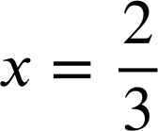
Forming and solving equations from worded problems
2) Andeep has made two number problems. Write an equation and find the number in each case.
x × 5 − 7 = x × 2 − 5
5x − 7 = 2x − 5
3x − 7 = −5
3x = 2
Andeep’s number is
b) I have another number whereby if you multiply it by 5 and minus 7 it’s the same as if you multiply it by 2 and minus 5

Slide 42
Forming and solving equations from worded problems
3) a) Jun, Aisha and Jacob are buying a present for a classmate.
Aisha spends £2 more than Jun and Jacob spends three times as much as Jun. In total they spend £39.50
How much does Jacob spend?
Jun
x
x
2
£39.50
Aisha
Jacob
x
x
x
5x + 2 = 39.50
Jacob spends 3 × £7.50 = £22.50
5x = 37.50
x = 7.50

Slide 43
Forming and solving equations from worded problems
3) b)
Aisha spends £5 more than Jun and Jacob spends four times as much as Aisha. Jacob spends £33 more than Aisha. How much does Jun spend?
Jun
x
£33
Aisha
x
5
Jacob
x
5
x
5
x
5
x
5
3(x + 5) = 33
x + 5 = 11
Jun spends £6
x = 6

Slide 44
Problem solving with linear equations
We can apply our knowledge of solving linear equations to efficiently solve a variety of problems from geometric ones to number/monetary ones.

Slide 45

© Oak National Academy 2023.
Produced in partnership with Mathematics in Education and Industry.
Licensed on the Open Government Licence v3.0, except where otherwise stated. See Oak terms and conditions.

